Slide 1
Technical Indicator Analysis
Team
Anshul Ahuja (B17CS006)
Anmol Gangwar Reddy (B17CS022)
Chakshu Gupta (B17CS061)
Mentor | Dr Sandeep Yadav

Slide 2
Average Directional Index(ADX)

Slide 3
ADX Funda
ADX is a trend indicator.
ADX attempts to measure the strength of price movement in positive and negative direction.
ADX is used together with two underlying indicators
Negative Directional Indicator (-DI)
Positive Directional Indicator (+DI)
ADX calculations are based on a moving average of price range expansion over a given period of time.
The default setting is 14 days.
ADX can be used on any trading instruments.

Slide 4
How to Trade using ADX?
ADX Value | Trend Strength
0-25 | Absent or Weak Trend
25-50 | Strong Trend
50-75 | Very Strong Trend
75-100 | Extremely Strong Trend
When
DI+ is above DI- , value of ADX measures strength of uptrend
DI- is above DI+ , value of ADX measures strength of downtrend
The crossover points where DI+ crosses over DI- and ADX > 25 is a good point to BUY. Because the predicted uptrend is strong.
The crossover points where DI- crosses over DI+ and ADX > 25 is a good point to SHORT SELL. Because the predicted downtrend is strong.

Slide 5
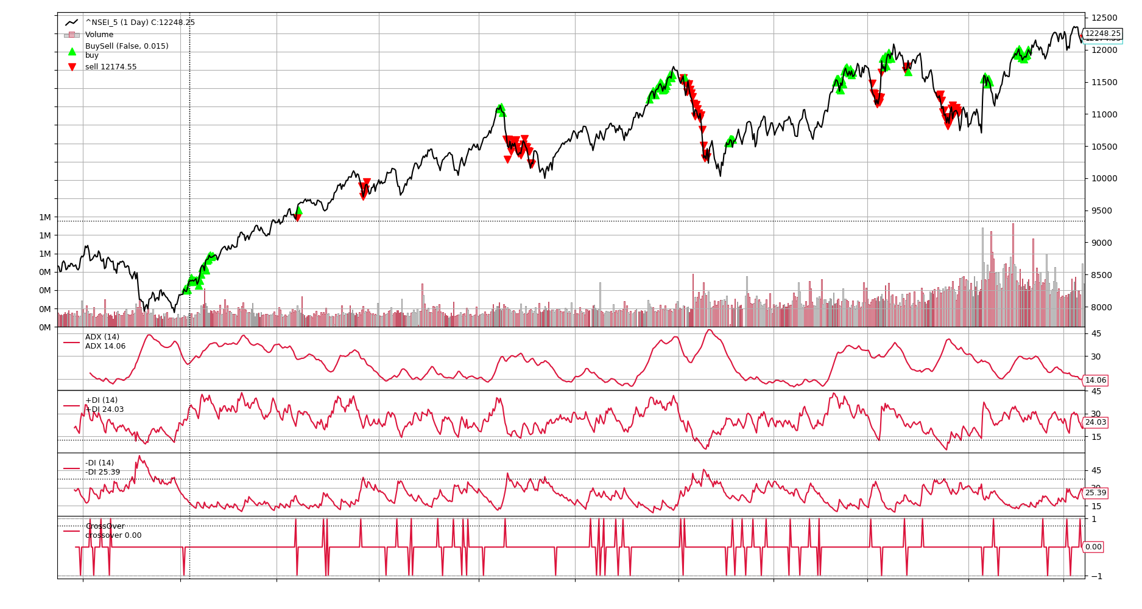

Slide 6
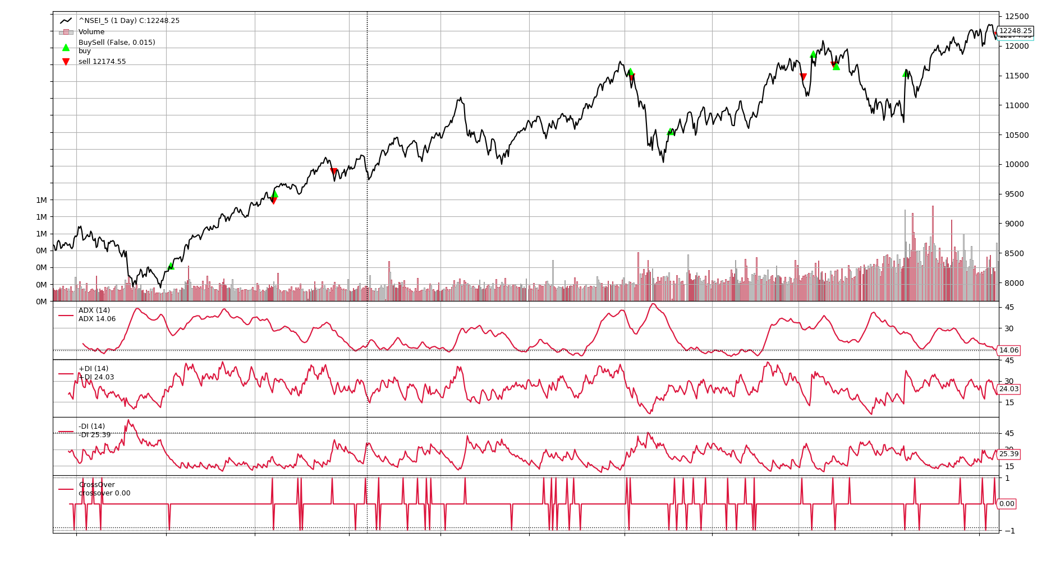

Slide 7
Ichimoku

Slide 8
Ichimoku Funda
Also known as Ichimoku Cloud or Ichimoku Kinko Hyo
It is a versatile Indicator that tells
Support and Resistance lines
Identifies Trend Direction.
Gauges Momentum
It uses five lines Tenkan-Sen, Kijun-Sen, Senkou Span a, Senkou Span b and Chikou Span.
All the mentioned lines are price averages with different periods with (9,26,26,52,26) days
Support and Resistance Lines
The green cloud indicates support line.
The Red Cloud indicates the resistance line

Slide 9
How to trade using Ichimoku?
Trend Direction.
The cloud and Kijun-sen or chikou span can be used to see trend Direction.
Momentum.
Price above the Baseline (Kijun-sen) momentum has been gained if cloud is green. (Uptrend)
Price below Baseline momentum has been gained if cloud is red (Downtrend).
How To Trade ?
Using Base line
Using Chikou line.

Slide 10
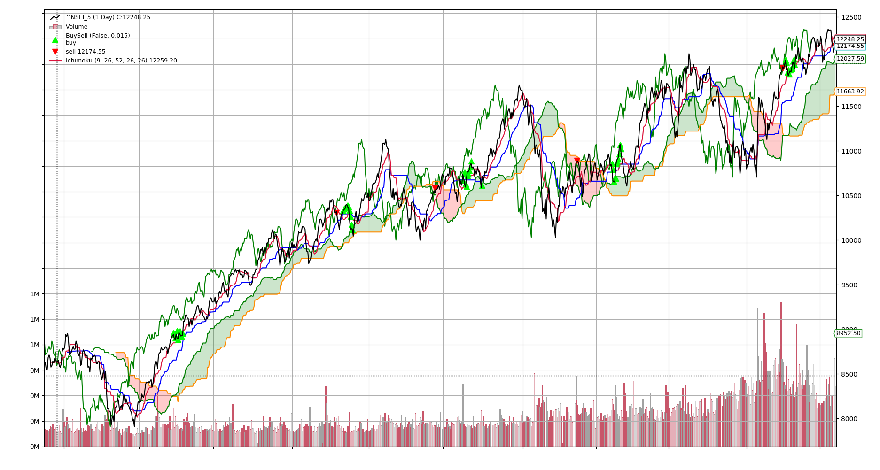
Basic Mathematics

Slide 11
Relative Strength Index

Slide 12
RSI Funda
Relative Strength Index = 100 - (100/(1 + RS))
Where RS = (Average of ‘D’ Days Gain/Average of ‘D’ Days Loss)
Where D is 14 usually
Where Absolute Gain = (Closing price on present day - Closing price on previous day)
Where Absolute Loss = -(Closing price on present day - Closing price on previous day)

Slide 13
How to trade with RSI?
IF RSI < 30
//Market is oversold => Price might eventually increase
IF reversal is confirmed
BUY
IF RSI > 70
//Market is overbought => Price might soon decline
IF confirmation of the reversal
SELL
The 50 level is the midline that separates the upper (Bullish) and lower (Bearish) territories.

Slide 14
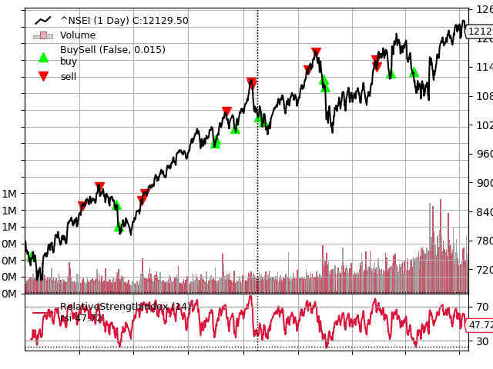
Notes:
INR 13073.58 on INR 10000

Slide 15
BIRA Ichimoku, RSI & ADX’s Brew

Slide 16
Motivation
Using Ichimoku and RSI there is a lot less trading points so we thought of using ADX for buying the stocks and ADX is very erratic and have high crossovers so even small dips get sold so we use Ichimoku to sell the stocks as it gives perfect selling points and small dips are taken into consideration.

Slide 17
Trading Strategy
Buy
We bought stocks using ADX when DMI Plus crosses over DMI Minus and ADX >25, Here we strengthened the buying using ADX Index.
Sell
While selling we used Ichimoku when Chikuspan < Actual_Price and RSI > 70 sell the stock as Chiku span shows 26 bars in the future and also RSI is used to strengthen this prediction.
BIRA Indicator Accuracy: 60%

Slide 18
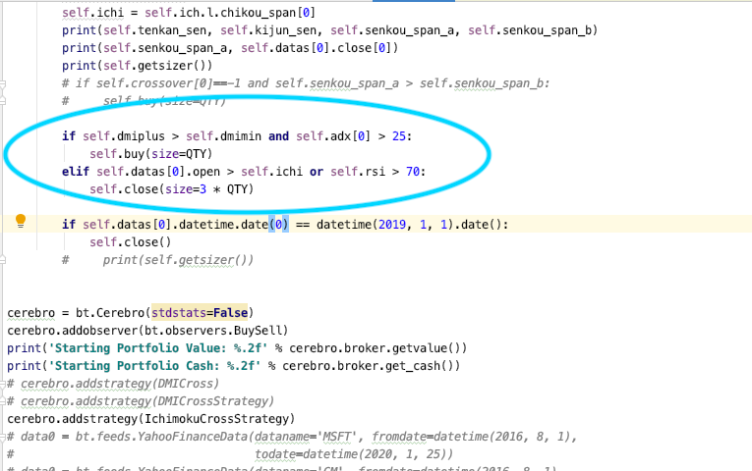

Slide 19
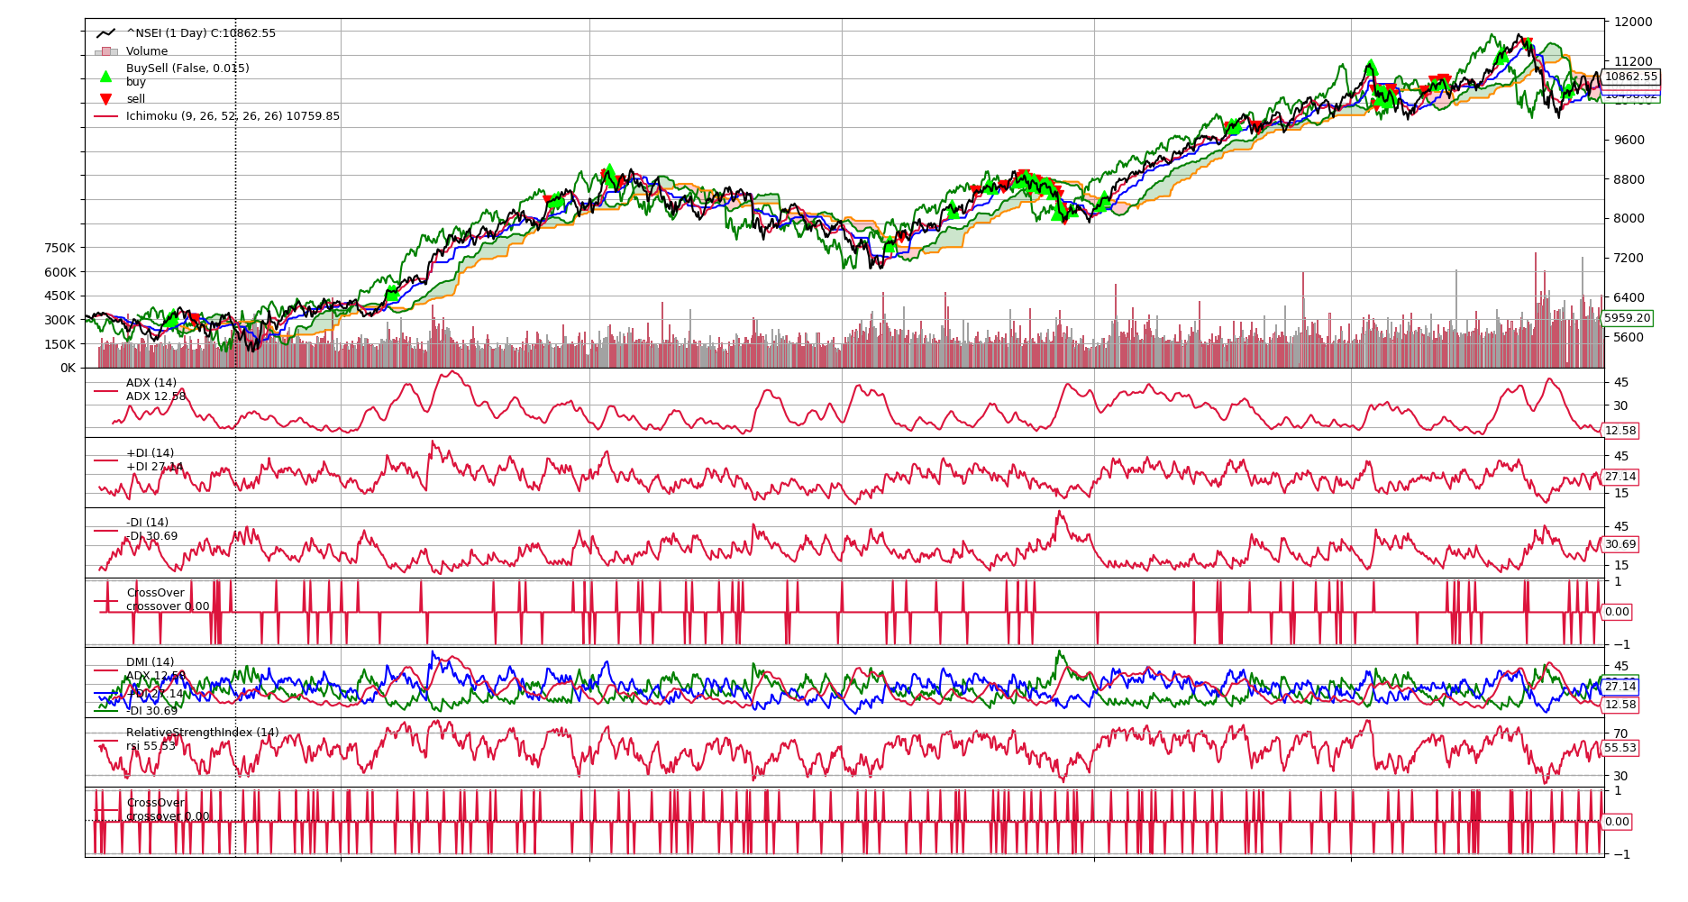

Slide 20
